Slide 1

Modality Effects on Future Student Success
The Chemistry Case Study

Slide 2

Bad Faith Argument: Our students are doing well overall
This takes the following forms
“Our students do better than their four-year peers”
“Our students do well after graduation”
So let’s unpack this one

Slide 3

What is the average college degree?
Come on, I’ll wait
Unless they’re majoring in chemigeobiomathephysienglisociopsychokinesthesiology, I’m guessing there is no such thing as an “average” degree
A general education is meant prepare you for any future degree, but doing well on average only tells you how well the program is doing overall, it makes no statement about how each program is doing individually
The odd thing is how easily we embrace this fallacy
If a student graduates with a 3.4 GPA, does that mean they got a B+ in every single class?
The individual courses make up the average, but the average cannot tell you how a student did for each individual course

Slide 4

Bad Faith Argument: When are they going to need this?
This takes the following forms
“It’s not like your course is the only course they’re going to need”
“It’s not like this course is used later in their degree”
“It’s okay if they don’t learn all of it”
So let’s unpack this one

Slide 5
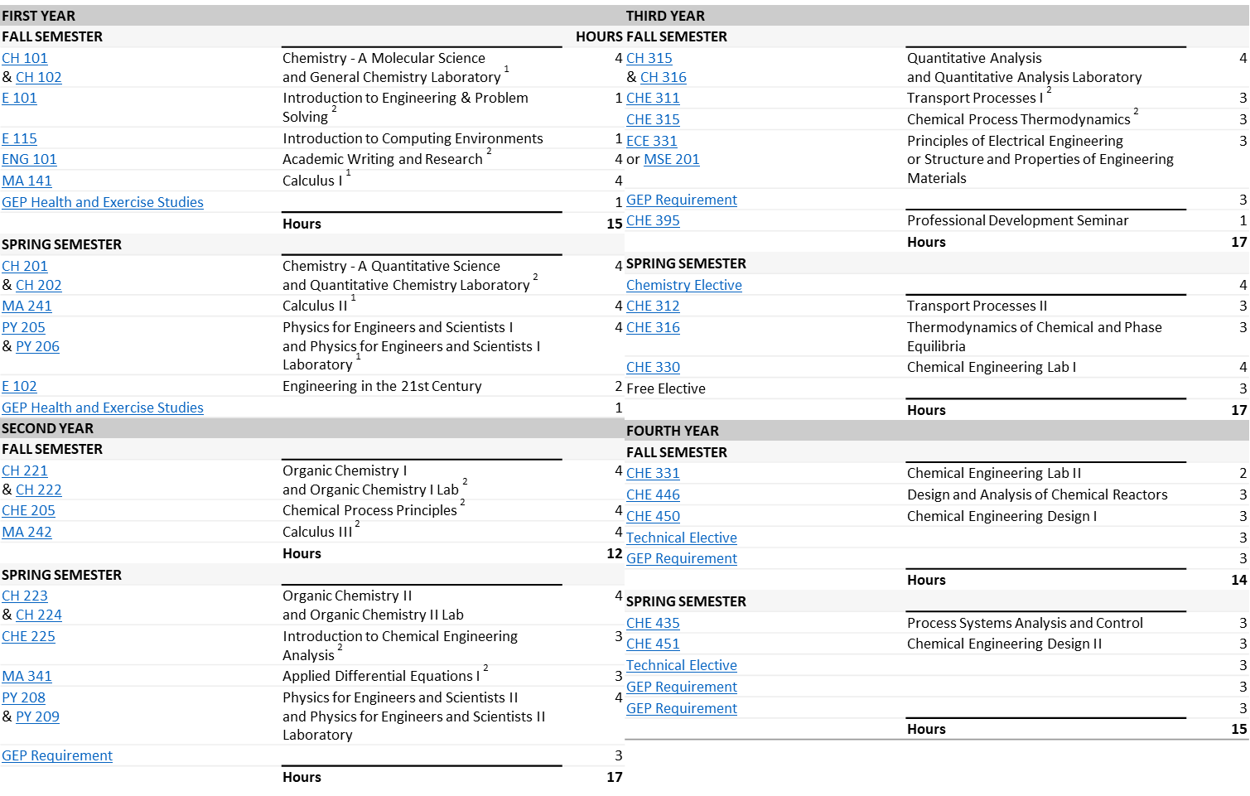
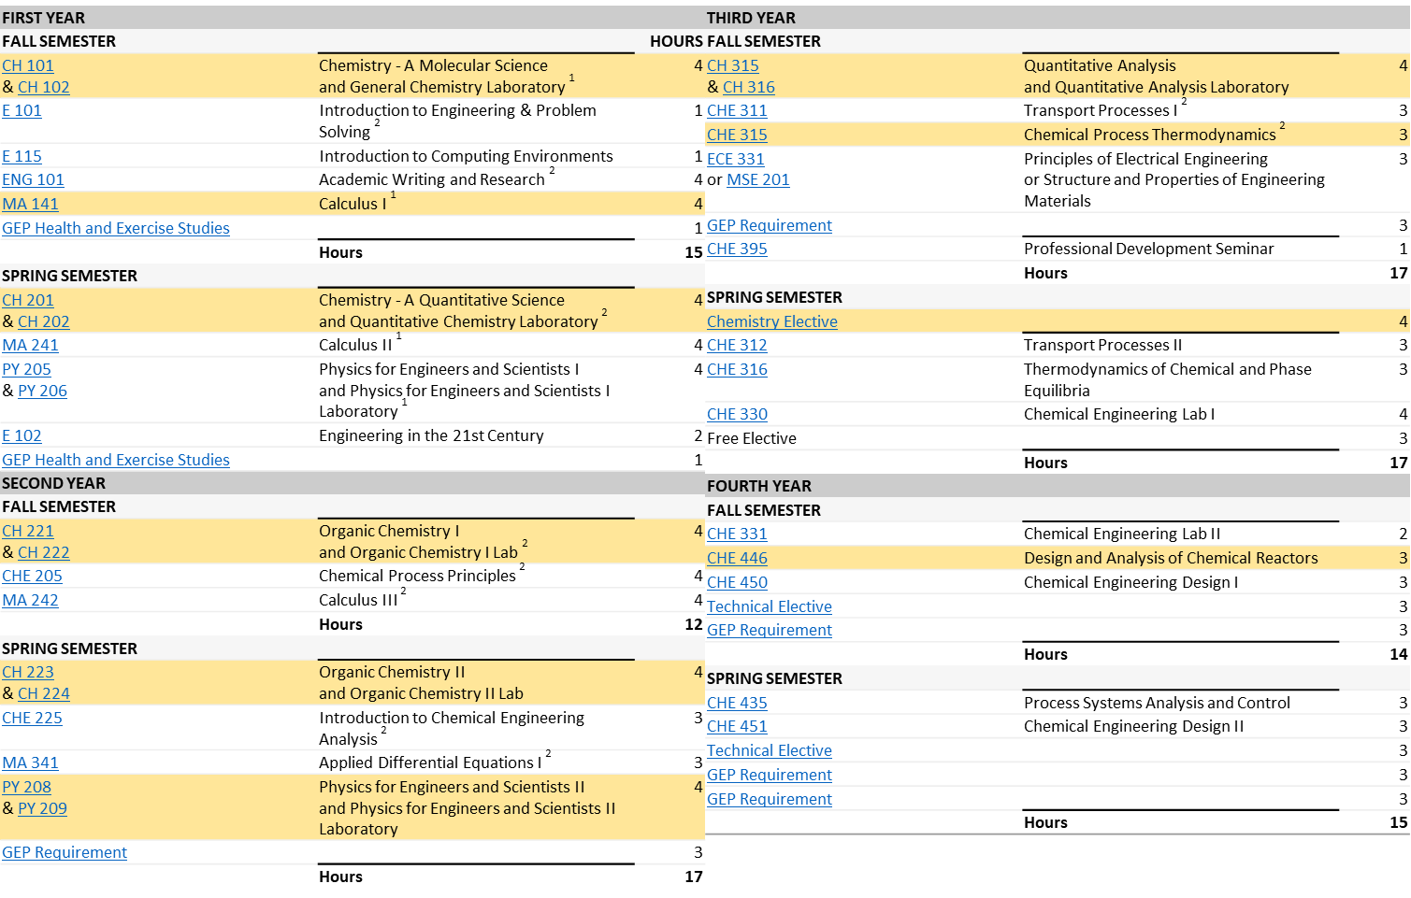
Chemical Engineering
This is a degree audit from NCSU
These are the courses that I needed to be successful in my career
And I double majored, so there were courses not on this list that were essential to my career
Most of what was taught in my major was not relevant to my career path, nor was it for my peers
But the thing is, it wasn’t the same topics that were and weren’t relevant – it depended on the career path

Slide 6
Across Majors
Now let’s get mean
If it’s not relevant, then why are we teaching it?
I had a graduate math instructor who said
“You’d think the way we taught calculus 95% of problems could be integrated, when in reality it’s only 5% - everything else is numerical.” Todd Squires
So are we dropping Calc II and III integration and switching to numerical integration?
95% of the world gets along just fine without using calculus
Does this mean that other majors get to dictate what is an isn’t covered in other fields?
Absolutely not
If I over-prepare a non-major you’d never notice
If I under-prepare a major, you’d definitely notice
It’s not a matter of whether they will or won’t use it, it’s a matter of whether or not there’s a good chance they may need it in the field being taught

Slide 7
Measuring Success
There is no single, universal metric for seeing how well our students are doing
Each metric we use can be misleading, or at the best capture unwanted data points
A variety of metrics are needed in order to capture the overall picture of programmatic efficacy
Consider SLO scores – does a high SLO score mean you taught well?
Reasons it could…
Students would do well if they were taught the material well
SLOs are general a blend of teaching and assessment styles, so it demonstrates it’s not just how the question is being asked
Reasons it could not…
Doesn’t measure information retention (students may only study the material for the final, then forget)
SLOs are inherently incomplete – they require a balance of depth and breadth within a 110 minute test window

Slide 8
A New Metric – Success in Future Courses
This is another metric we should be adding to our repertoire
It measures how well a student does in future courses
Like all metrics, there are also unwanted data points that we unfortunately cannot screen out
However, taken in the context with other measurements, can be used to better assess programmatic health
Pros
It can measure how well fundamental knowledge is being retained (indirectly) via how well their grades track between courses
Averages out instructor contributions and local trends
Cons
Requires larger windows of time to measure
Doesn’t factor in course difficulty
Assumes students took the previous unit here

Slide 9
The Study: Overview
I asked Wake Tech IE to give me the grade-pairs of students who took sequenced courses, e.g., 151/152
I plotted the students grade in the first course (e.g., 151) versus their grade in the subsequent course (e.g., 152)
Obviously they had to get a C or higher in the previous course to move on
The core courses were looked at (151/152/251/252), but the script written for this can be adapted to handle all sequenced courses and all majors, if need be – the limitation in the IE office request (this one took three months)
Sets were broken down by demographic and mode of delivery
Sets with less than 100 students were ignored

Slide 10

The Study: Methodology
Sets were compared over a 10-year span (since the EPIC mandate went into effect)
Yes, it includes COVID data
It is possible to filter for pre- and post-COVID but at the costs of data points
It does not consider campus or instructor
It does not filter out students who had to repeat the course earlier
The study looked at 4456 students over this 10-year range

Slide 11
Overall (all course pairs)
Let’s start big picture
Regardless of course delivery (starting and finishing), demographics, and course, it’s kinda what you’d expect
A students tend to be A students, etc.
B students seem to have the largest decline, whereas C students tend to improve if they change
But it does give us a good baseline to compare against, so let’s break it down by course

Slide 12
151-152 Versus Baseline
Let’s consider our largest contribution the 151/152 set
Since it’s the majority of data points, it’s going to dominate the analysis
Pretty much the same, so how do the higher courses turn out?

Slide 13
151-251 Versus Baseline
Organic loses data points because a fair number of students aren’t Wake Tech Students (>50% in SP22)
Our A students finally hit a hard class, but our B and C students remain fairly the same

Slide 14
251-252 Versus Baseline
We now begin to recover our old distribution again
So what can we say?
We see a larger drop off in A students from 152 to 251
In general, A students will stay A students (mostly) with most converting to B and relatively few dropping to C, D, or below
B students both improve and decline a letter grade, with most (but not a simple majority) keeping the same grade
This is also true of C students
Students with a lower grade in the previous course are more likely to take a W/WF/WP/WE in future courses

Slide 15
Overall – Ethnicity
Here we will compare the overall to Asian, Black/African American, Hispanic, Multiethnicity, and White/Caucasian
There were only 46 Native American Students, so I can report the number but it would be very shaky
I am omitting the unknown and “foreign” tags (the latter…just why IE?)
They are included in the overall distributions

Slide 16
White/Caucasian
Making up nearly half the sampled population (woot-woot, we’re actually minority serving after all), they tend to set the average
So instead of comparing the average, let’s compare the groups to each other
In general, we see that A students tend to be A students, etc.

Slide 17
Asian
Asian A students tend to retain their grades in higher courses much better than their Caucasian peers
However, for B and C students, the retention/improvement/decline in grades is roughly the same, though C students do tend to improve more than their Caucasian peers

Slide 18
Black/African American
It is definitely with our Black/African American populations, as well as our other minority students, where the grade retention for A students begins to suffer
Unlike their Asian and Caucasian peers, less than half are able to maintain their A’s
B students are more likely to become C students than keep their Bs
And C student tend to remain constant, though a larger percentage are more likely to have a W/WF/WP/WE than their peers

Slide 19
Hispanic
Hispanic populations show similar trends
Most will not keep their A, and those entering with a previous C are just as likely to keep their C are they are to withdraw
B students are just as likely to become B or C students in the next course

Slide 20
Multiracial Students
Multiracial students are nearing the limit for what can be reported here (probably where there are no D’s)
We may be able to infer similar trends to other minority students other than Asian students
So, overall, students who are not Caucasian or Asian typically lose a letter grade in higher courses, especially if they were A students to begin with

Slide 21
Ethnicity and Starting Grade Distribution
So we have percentage retentions, but what percent of our incoming students fall into each category?
Overall minority groups except Asian students aren’t not starting out as well as their Caucasian peers
In order to help these students succeed, we need to help them retain their grades (if not raise them) as much as possible
So how does this compare between online and in-person courses?

Slide 22
Breakdown Verses Deployment (Data)

Slide 23
Breakdown Verses Deployment (Discussion)
As with previous slides there are three important notes here
White/Caucasian data points constitute a majority of the overall trends
151/152 data points are the heaviest contributors to these trends
We’re going to try to stick to N = 100 (ergo why multiracial is missing as are hybrid courses)
For incoming students, more students are starting out with A/B’s in seated than they are in online
This is particularly true for Black/African American populations, with only Hispanic populations going against this trend

Slide 24
How Groups Are Finishing (Data)

Slide 25
How Groups Are Finishing (Discussion)
As with previous slides there are three important notes here
White/Caucasian data points constitute a majority of the overall trends
151/152 data points are the heaviest contributors to these trends
On switching to any deployment method, overall students starting out in-person are doing better than their online peers
This particularly true for minority students
This data does not explain the roots of these differences but there are some possibilities
Minority students aren’t as well equipped for online courses
A majority of online course resources are online, so students who lack access to good internet connections or aren’t well adapted to the online environment will do worse
Lack of support
Being on campus provides easier access to the course instructor as well as other instructors
It provides easier access to the ILC and other campus centers
Being on campus makes it easier to connect with other students

Slide 26
Overall Verses Deployment
Here we will consider three forms of deployment
Online (lab kit, virtual lecture)
Hybrid (in-person lab, virtual lecture)
In-person (in-person lab and lecture)
There is a lot to correlate here
What method of deployment did they start with?
What method deployment did they go with for the second course?
Where they and A, B, or C student before they went into the next course
So keep in mind, you’re going to have to break this into slices and it’s a lot to put into slide-form
This is not broken down by ethnicity due to finite sample size

Slide 27
Starting Online, Finishing Online
In going from one method of deployment to the same method in the next course, we are seeing a lot of consistency with students
C students represent a high-risk group as they are more likely to withdraw than anything else
B students tend to skew downwards, but with C students, there tends to be mobility upwards as well
The trends in these courses capture the macroscopic trends seen across all courses

Slide 28
Starting Online, Finishing Hybrid
But when students make the jump from online to hybrid, we see a drop off in performance
B and C students are at large risk of withdrawing
The earliest combination would be online 151 and in person 152
The latest combination would be online 152 to in person 251

Slide 29
Starting Online, Finishing In-Person
Similarly our online students struggle to make the jump from online to in-person lab lecture
B and C students are at large risk of withdrawing

Slide 30
Starting In-Person, Finishing Online
Grade retention is lower in a switch from in-person to online
B and C students in particular are at risk for withdrawing from the course

Slide 31
Starting In-Person, Finishing Hybrid
A students do not seem to make the jump from in-person to hybrid well
B and C students tend to keep their grades, but C students in particular are at a large risk of withdrawing, as was seen with an online course

Slide 32
Starting In-Person, Finishing In-Person
A student retention stays consistent with the other deployment methods
B and C students are much better retained at the same rate as their counterparts in online-online

Slide 33
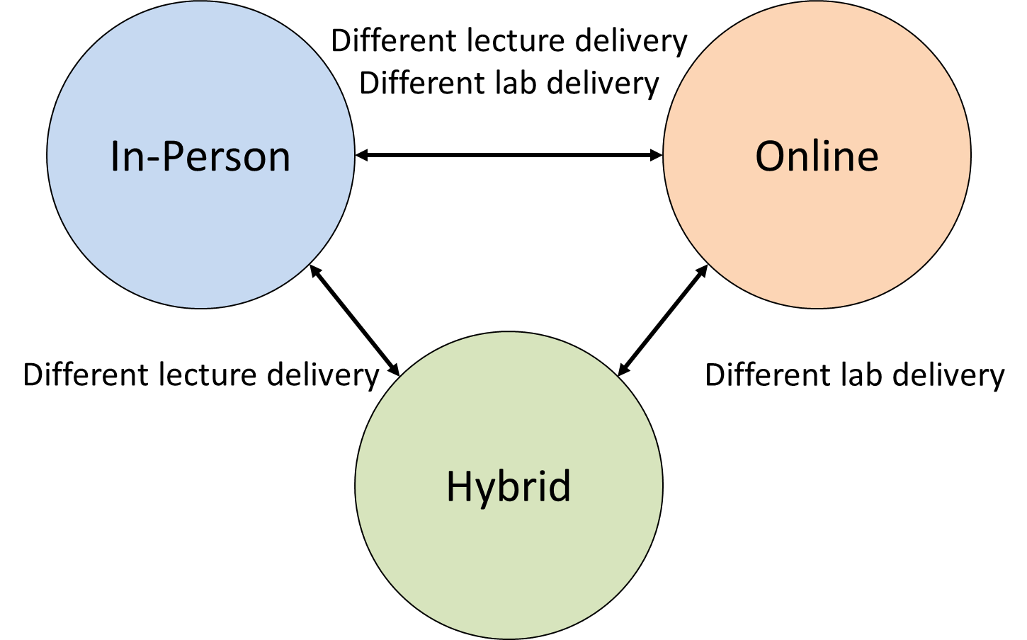
Comparing Between Data Sets
Let’s consider what what’s changing between the different modalities
Hybrid is what the name implies, an intermediate between online and in-person modalities
We can use differences between in-person/hybrid and online/hybrid to draw inferences about how the different modalities impact student success

Slide 34
The Labs – Online Verses Online/Hybrid
While this data contains some 152/251 data points (N < 100) the majority of these 680 data points represent 151/152 transition
The left column is online-online, the right is online-hybrid
When students switch from in-person to hybrid, the only change here is the lecture
Let’s take all things being equal, meaning that students taking online and hybrid are equally good learners in the online space
The decline in the success of mostly A students, with marginal changes in B and C students, implies that students are struggling mostly in the lab
In other words, the online courses are not preparing students adequately for the labs, especially high performing students
Online-online
Online-hybrid

Slide 35
The Lectures – Online Verses Hybrid/In-person
Using the switch to hybrid as a baseline for the lab effects, we can now compare to in-person
If the lab is the only thing causing the shift in grades, the distributions should be comparable for online-hybrid and online-in-person groups
However, the online to in-person groups are generally doing better than their hybrid peers, especially the A students
This would imply then that there is an added benefit for switching from the online directly to an in-person delivery method and not going to hybrid
Online-hybrid
Online-in person

Slide 36
The Labs – Online Verses Online/Hybrid
While this data contains some 152/251 data points (N < 100) the majority of these 453 data points represent 151/152 transition
The left column is online-online, the right is online-hybrid
When students switch from online to hybrid, the only change here is the lab
Let’s take all things being equal, meaning that students taking online and hybrid are equally good learners in the lab
The decline in the success of mostly A students, with marginal changes in B and C students, implies that students are struggling with the change in delivery methods
In person – in person
In person – hybrid

Slide 37
The Lectures – In-Person Verses Hybrid-Online
Similarly using the switch to hybrid as a baseline for the lecture effects, we can now compare to online groups
If the lab is the only thing causing the shift in grades, the distributions should be comparable for in person-hybrid and in person-online group
However, the in-person to online groups are generally doing better than their hybrid peers, especially the A students
This would imply then that there is an added benefit for switching from the online directly to an in-person delivery method and not going to hybrid
In person – hybrid
In person – online

Slide 38
Switching Students Entirely
So how do they compare?
Honestly it looks like a wash when students swap modalities entirely
The differences in delivery method and lab offerings seem to cancel each other out despite individually raising and lowering transitions
Does that mean they’re both viable?
Well…
Online – In-person
In-person – Online

Slide 39

Bad Faith Argument: Students are warming up to online courses
How many if you have you heard
“Students have tried online courses and feel more confident”
“Students are really demanding online courses after trying them”
Let’s start this by asking ourselves this – why weren’t they taking them before?

Slide 40

Ask yourself the following…
Do you think you’d do well taking the following courses online (assuming they offered the same resources as you do)?
Intro to Psychology
Organic Chemistry I
Particle Physics
Introduction to Solving Langevin Problems
Quantum Chemistry
String Theory
Why wasn’t your answer the same for all of them?
Hmm, sounds like you’re interpolating based on your previous experiences, but let’s consider our students

Slide 41
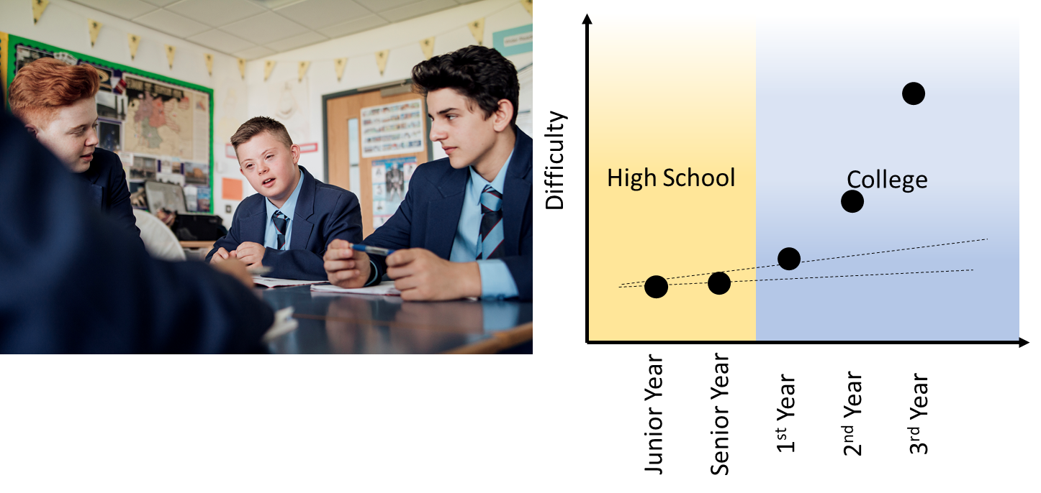
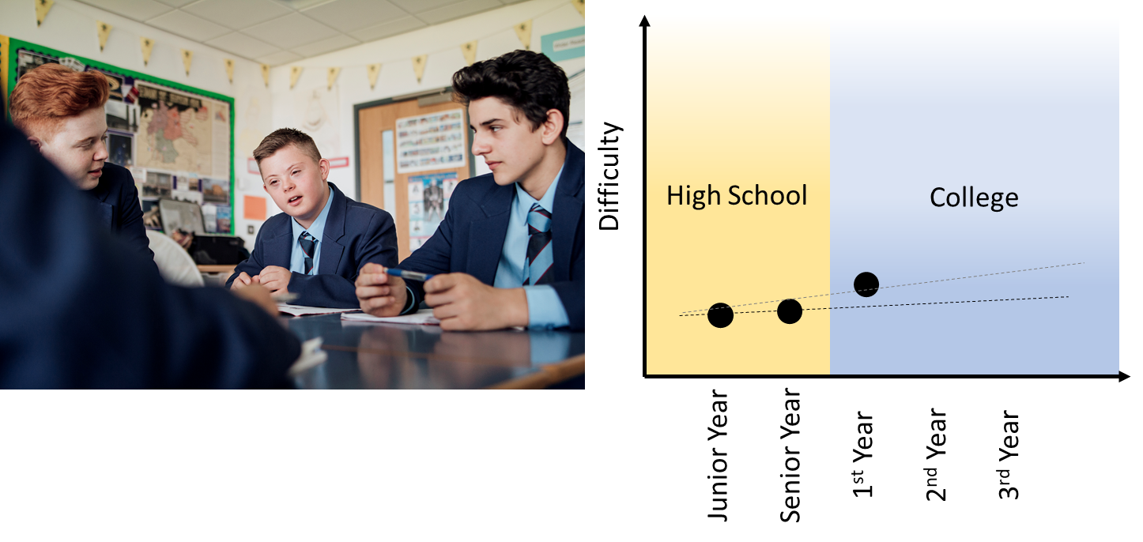
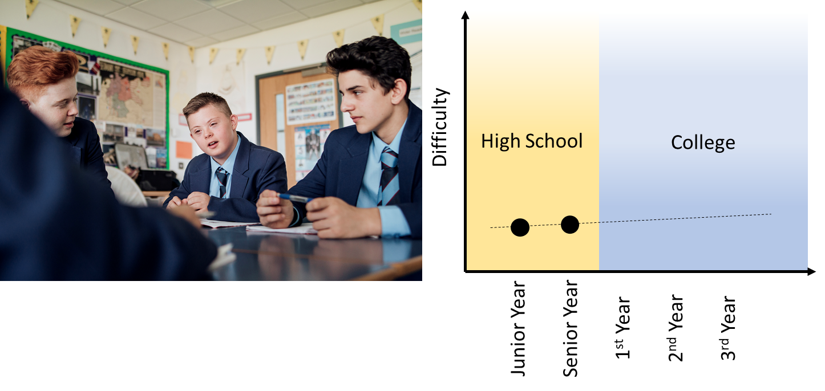
Students are dumb (and it’s not their fault)
When students choose the next method of deployment they must go off what they already know
In this sense, they’re extrapolating off of their previous high school experiences
Pre-COVID many faculty complained students came in thinking it was just going to be high school
Guess what…they’re still doing that!
So students may be “warming up” to online, but doing so in courses that aren’t that hard to begin with
We are effectively letting students (poorly) self-assess their strengths

Slide 42
Conclusions (so far)
Online labs are not preparing our students well for in person labs, which has an impact on future success
Students handle the transition from online to in-person better than online to hybrid, and the reverse is true for in-person to online
Hybrids are not a good compromise – students do better (relatively) switching between in-person/online
Starting out online has a disproportionately larger negative impact on minority students than Caucasian and Asian students when ignoring what modality they finish in
In the long run, we must decide if it’s appropriate to have students transition from online to in person, or force most to start out in-person

